Slide 1






ENERGY
SUSTAINABILITY
RESEARCH & DEVELOPMENT CENTER
MODELING AND SIMULATION OF DIESEL, BIODIESEL AND BIOGAS MIXTURES DRIVEN COMPRESSION IGNITION INTERNAL COMBUSTION ENGINES (CI-ICE)
Vilmar Graciano, Jose Viriato C. Vargas, and Juan C. Ordonez International Journal of Energy Research, 2016, 40:100–111. DOI: 10.1002/er.3286

Slide 2

TOPICS
MOTIVATION
BIBLIOGRAPHIC REVIEW and OBJECTIVES
MATHEMATICAL MODEL
RESULTS AND DISCUSSION
CONCLUSIONS
2

Slide 3
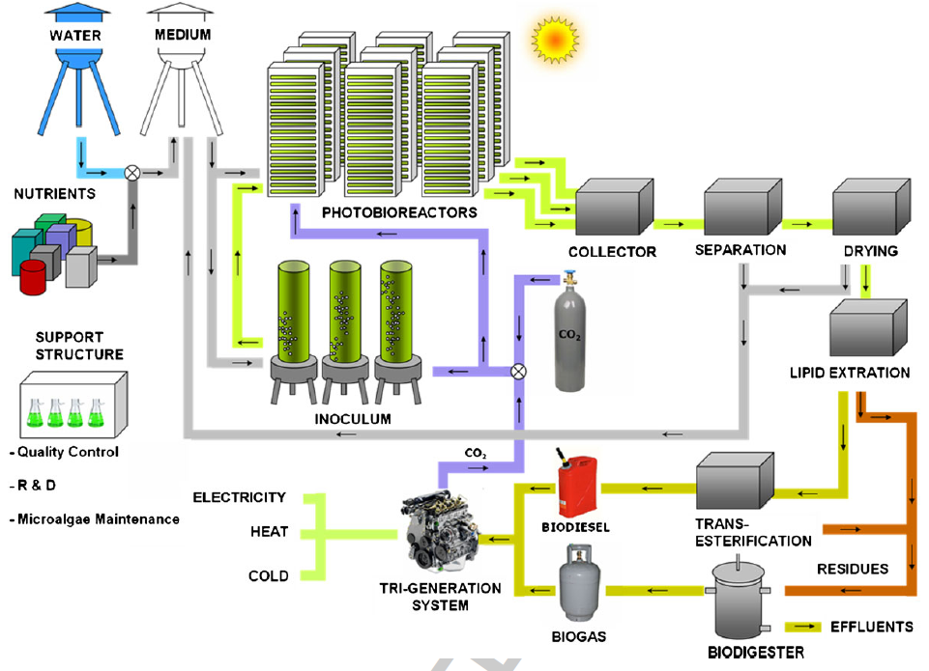
1. MOTIVATION
Plant summary
H₂ for trigenerator

Slide 4
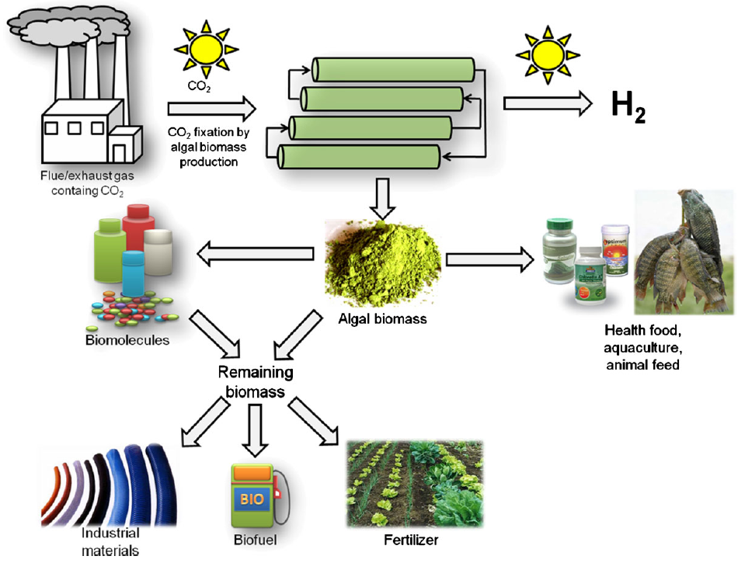

Slide 5
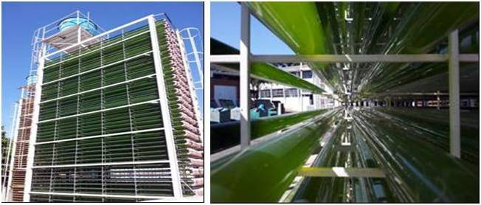

Slide 6
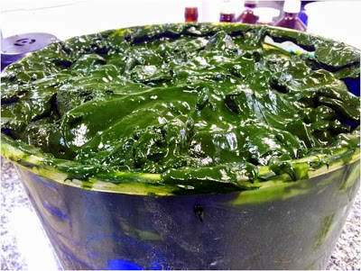
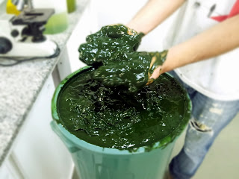
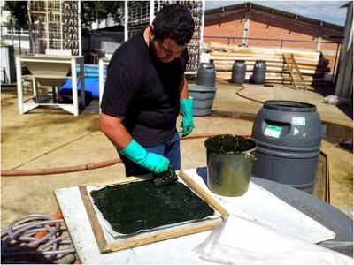
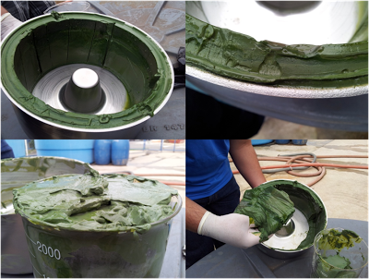
CURRENT STAGE

Slide 7
2. BIBLIOGRAPHIC REVIEW and objectives
2.1. Current main trends in Research and Development (R&D) of CI engines
R&D for better use of energy sources - cogeneration and trigeneration based on CI engines - (Abusoglu et al. (2009), Katri et al. (2010) and Temir at al. (2004));
CI engines new and alternative fuels - (Bueno et al. (2011), Jimenez et al. (2012), Lebedevas et al. (2011) and Papagiannakis et al. (2010)), and;
R&D of componentes - combustion chambers - fuel injectors, more efficient CI engines, new and complex models - (Gogoi et al. (2010), Giakomis et al. (2007) and Rakopoulos et al. (2004).

Slide 8
2.2. Challenges
Low availability of fast and accurate computer applications for the simulation of the 4-stroke CI engine
No availability of fast and accurate computer applications for the simulation of the 4-stroke CI engine with alternative fuels (including combustion)
Low availability of fast and accurate computer applications for the simulation of the 4-stroke CI engine for control and optimization

Slide 9
Constructal theory
Evolution Theory – originally conceived for biological organisms
Constructal Law – unifies all systems design (Bejan, 1996) “For a flow system to persist in time (to survive) it must evolve in such a way that it provides easier and easier access to the currents that flow through it.”
Traditional ICE design: assumed components (e.g., heat exchangers) geometry (or configuration) → optimization
Constructal ICE design: principle-based generation of flow-system architecture → components free to morph under global constraints
New: focus on the principle and method of generating geometry (shape, structure, configuration) for energy systems with flows of fluid, heat, electricity and mass

Slide 10
2.3. Objectives
To develop a simplified transient mathematical model for 4-stroke CI engines powered by diesel, natural gas and biodiesel mixtures
Adjustment and experimental validation of the model
Parametric analysis
To utilize a simplified dynamic mathematical model for 4-stroke CI engines powered by diesel, biodiesel, and biogas mixtures to propose a path for the CI-ICE constructal design.

Slide 11
Mathematical model
The model was developed for a 4-stroke CI engine, using the conservation of mass and energy princples.
3.1. Assumptions of the model for all strokes
Gas mixture inside the cylinder behave as ideal gases
Pressure and temperature inside the cylinder → homogeneous throughout the working space
Negligible potential and kinetic energy variations
Standard conditions → p₀ = 101,300.00 N m⁻² (p₀ = p_{atm}), T₀ = 298.15 K and z₀ = 0 (sea level).

Slide 12
3.2. Working space
AV – admission valve; BDC – bottom dead center; CS – crankshaft diameter, [m]; EV – exhaust valve; H_{cyl} – cylinder height, [m]; p_{cyl} – gas mixture pressure, [N m⁻²]; ROD – connecting-rod length, [m]; P_{d} – piston diameter, [m]; T_{cyl} – gas mixture temperature, [K]; θ – crankshaft angle, [rad]; TDC – top dead center; V_{cyl} – cylinder volume, [m³]; V_{d} – displaced cylinder volume, [m³].
Fuel injector
AV
EV
TDC
p_{cyl}
T_{cyl}
H_{cyl}
V_{cyl}
V_{d}
P_{d}
BDC
Piston
ROD
θ
CS

Slide 13
3.3. Governing equations
Auxiliary equations
Height of the piston:
(1)
Instantaneous volume:
(2)
Specif heat at constant
pressure or volume:
(3)
Gas mixture constant:
(4)
Air enthalpy:
(5)
Fuel enthalpy:
(6)

Slide 14
Gas mixture enthalpy:
(7)
Heat transfer from or to cylinder walls in all strokes
Total heat transfer
(8)
Convection heat transfer:
(9)
Convection heat transfer
coefficient:
(10)
Reynolds number based on
piston diameter:
(11)
Piston mean speed:
(12)

Slide 15
Cylinder area:
(13)
Radiation heat transfer:
(14)
Equations used in the ADMISSION AND EXHAUST STROKES
Air flow rate:
(15)
Fuel flow rate:
(16)
Cylinder total mass:
(17)
Instantaneous pressure:
Instantaneous
temperature:
(18)
(19)
15

Slide 16
Equation used in COMPRESSION AND EXPANSION STROKES
Instantaneous temperature:
(20)
Equations used in the COMBUSTION
Combustion reaction:
(21)
The inverse of the
Equivalence ratio:
(22)
Heat of combustion
in molar basis:
(23)
Heat of combustion
in mass basis:
(24)
Fuel mol:
(25)

Slide 17
Heat transfer rate supplied
by combustion:
(26)
Combustion time and cutoff ratio:
(27)
Instantaneous pressure
in combustion process:
(28)
Engine net power, torque and efficiency:
Mean indicated pressure:
, with
(29)
Mean friction pressure:
(Heywood, 1988)
(30)
(31)
Mean effective pressure:

Slide 18
Cylinder net work:
Fuel pumping work:
Engine net torque:
Engine net and mechanical efficiency:
Model adjustment using constant coeficients as multipliers (Inverse Problem of Parameter Estimation – IPPE) – 4LD2500 and MWM 229.6
Total heat transfer:
Mean friction pressure:

Slide 19
19
Fortran computational code → system of ODEs with complementary algebraic equations → pressure-volume diagram of the CI-ICE → adaptive time step 4th/5th order Runge–Kutta–Fehlberg method
Boundary Value Problem (BVP) – thermodynamic cycle simulation – special process – starts and ends at the same thermodynamic state
Starting point: top dead center.

Slide 20
20
4. RESULTS AND DISCUSSION

Slide 21
4. RESULTS AND DISCUSSION
Hourly fuel consumption and net power output of the Lintec 4LD 2500 CI-ICE engine, used for model adjustment.
Notes:
Fossil diesel

Slide 22
Hourly fuel consumption and net power output of the Agrale M790 CI-ICE engine, used for model experimental validation.
Notes:
Fossil diesel

Slide 23
The effect of biodiesel and diesel fuel mixtures on the hourly fuel consumption and net power output of the Lintec 4LD 2500 CI-ICE engine.
Notes:
Net power is almost the same at the expense of more fuel consumption mainly at low and médium speeds

Slide 24
The effect of natural gas and diesel fuel mixtures on the hourly fuel consumption and net power output of the Lintec 4LD 2500 CI-ICE engine.
Notes:
Net power is almost the same – FC is much lower with natural gas due to higher LHV

Slide 25
The effect of natural gas and biodiesel fuel mixtures on the hourly fuel consumption and net power output of the Lintec 4LD 2500 CI-ICE engine.
Notes:
Lower FC with natural gas – same net power due to natural gas higher LHV

Slide 26
The effect of natural gas, biodiesel and diesel fuel mixtures on the hourly fuel consumption and net power output of the Lintec 4LD 2500 CI-ICE engine.
Notes:
It was possible to find a fuel mixture that leads to lower FC while keeping same net power – fast and accurate model allows for fuel mixture optimization!!

Slide 27
The maximization of performance with respect to cutoff ratio (constructal design)

Slide 28
5. CONCLUSIONS

Slide 29
THANK YOU!

