Slide 1

TMEC005 – TERMODINÂMICA
Segunda Lei da Termodinâmica
Aula Nr 5
Prof. José Viriato Coelho Vargas

Slide 2
THE SECOND LAW OF THERMODYNAMICS
Not all processes that comply with the energy conservation principle in fact are possible.
Spontaneous processes are a special class of processes that happen in one particular direction, not in the inverse direction, although energy could be conserved.
The first law does not distinguish between the processes that can happen from those that cannot. Ex: spontaneous cooling of a hot body placed in contact with a colder environment → the body cools down to reach equilibrium with the temperature of the surroundings, and the inverse does not happen spontaneously, although the first law is satisfied.
When there is a combination of systems interacting energetically, a clear orientation is needed to predict what will result. For that, several scientists proposed the second law of thermodynamics as the principle to provide that guidance.

Slide 3
Thermodynamic reservoir
System in which a specific property remains unchanged despite the energy interactions experienced with other surrounding systems, such as temperature, pressure, and concentration.
Ex: Thermal reservoir – the planet’s atmosphere, oceans, large metal blocks, pure substances undergoing a change of phase at constant temperature and pressure (pressure reservoir).
Irreversibility
Process starting at a known thermodynamic state. Process is defined as irreversible if, after the process finishes, the system and the surroundings original states cannot be reestablished. Otherwise, the process is defined as reversible.
In the irreversible process, the system could return to its original state, but the surroundings state would no longer be its original state.
Processes that include heat transfer from a hot to a cold body; unconstrained expansion of a gas or liquid; friction; electric resistance; plastic deformation, and other spontaneous events, are irreversible. In sum, all actual processes are irreversible.

Slide 4
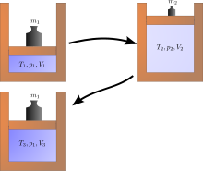
Examples of irreversible processes: Joule expansion
(neste caso, processo adiabático irreversível)

Slide 5
i) Heat transfer: this is possibly the most paradoxical one. Heat transfer happens spontaneously from a higher to a lower temperature. Work input would be necessary for heat transfer to occur from a lower to a higher temperature, such as in a heat pump. It is desirable to reduce temperature differences to a minimum across heat exchangers, but they cannot be zero, otherwise no heat transfer will occur. On the other hand, heat transfer rates by conduction, convection and radiation increase as temperature differences increase → a balance of such tradeoffs is mandatory for adequate heat exchanger design to avoid loss of efficiency in actual systems;
ii) Friction: for didactical purposes, friction is usually separated in mechanical and fluid. Heat dissipation is caused by mechanical work done by rotating shafts and other moving parts (e.g., translational actuators). The same amount of dissipated heat added to the component would not result in shaft rotation, i.e., the process is not reversible;
iii) Throttling: in this process a fluid expands from a high to low pressure location through a narrow opening (e.g., an orifice, a leakage from a high-pressure pipe). First law of thermodynamics shows that the process is isenthalpic, namely a Joule-Thompson expansion. Clearly, the flow could not happen from the low to high pressure location, i.e., the process is irreversible. However, throttling is necessary in some thermal machines components (e.g., refrigeration systems).
iv) Mixing: for several purposes, two or more fluids can be mixed, but cannot be unmixed without energy expenditure, therefore irreversible.

Slide 6
Irreversibilities: external and internal
External: across the system boundaries, e.g., in a power system, heat transfer at the high- and low-temperature ends, mechanical friction in rotating shafts, and electrical losses.
Internal: inside the system boundaries, mostly due to fluid friction in all components, throttling and mixing.
The effects that make real processes irreversible are termed irreversibilities (nonidealities or thermodynamic losses)
Reversible processes establish the limit of ideal operation.
Conclusion: The quantification and possible minimization of irreversibilities is highly desirable in systems engineering design and operation.

Slide 7
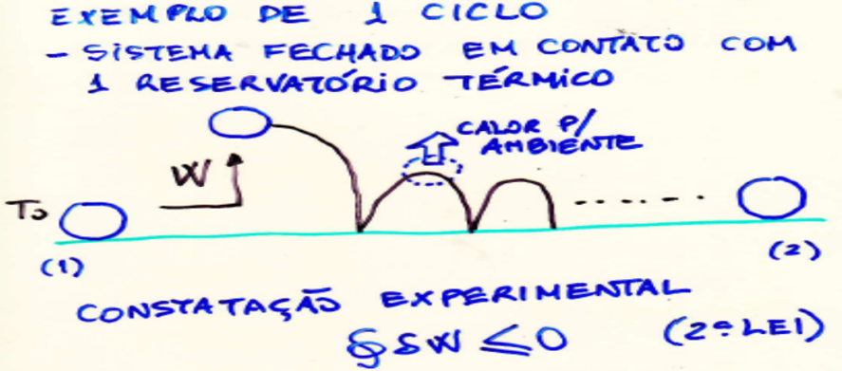
History of thermodynamics: many experiments were conceived of systems operating cyclically in contact with one temperature reservoir. Ex: Joule’s measurements of the mechanical equivalent of heat. All such experiments showed that the tested systems received work and rejected heat, never the opposite.
The 2nd Law of thermodynamics for a cycle

Slide 8
From experimental observations, Max Planck and Lord Kelvin in different moments proposed the following second law statement:
“It is impossible to construct an engine which will work in a complete cycle and produce no effect except the raising of a weight and the cooling of a heat-reservoir”,
which would be the inverse of Joule’s paddle wheel experiment.
Rudolf Clausius also proposed a statement :
“It is impossible for any system to operate in such a way that the sole result would be an energy transfer by heat from a cooler to a hotter body”.
In fact, the Clausius and Kelvin–Planck statements are equivalent.

Slide 9
1st Law of thermodynamics for the cycle states that:
So, the 2nd Law of thermodynamics for the cycle states that:
In a cycle, the system initial and end states are the same, and the equal sign means that the net work and heat exchanged with the surroundings are equal to zero, thus both the system and the surroundings original states are the same. As a result, the equal sign means that the cycle is reversible. When…
Internal irreversibilities (e.g., friction) convert the work input into internal energy that is rejected by heat transfer to the surroundings, thus the cycle is irreversible.

Slide 10
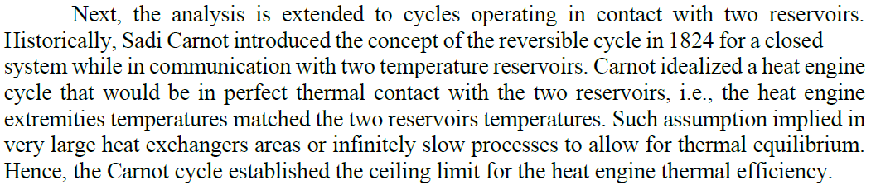
Closed system in a cycle in contact with two temperature
reservoirs
2 RESERVATÓRIOS – CICLO DE CARNOT

Slide 11
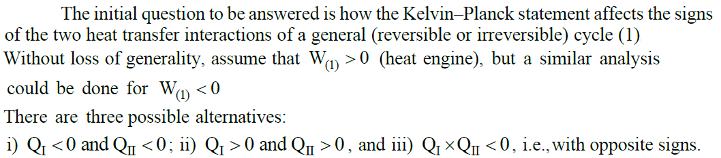
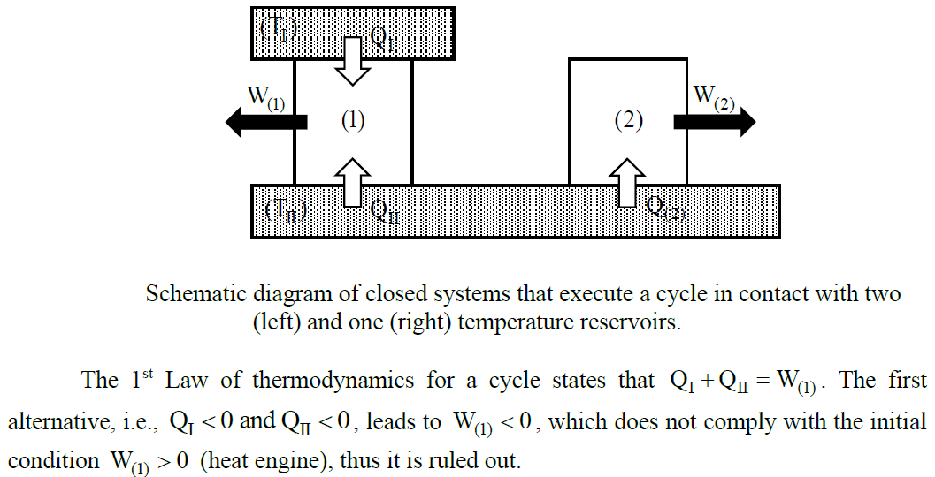

Slide 12
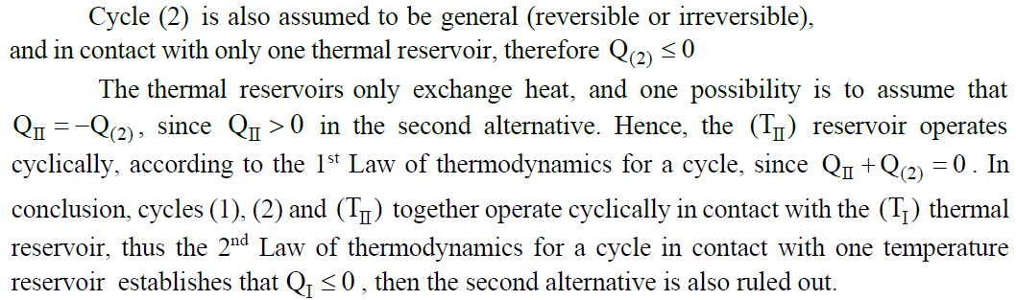
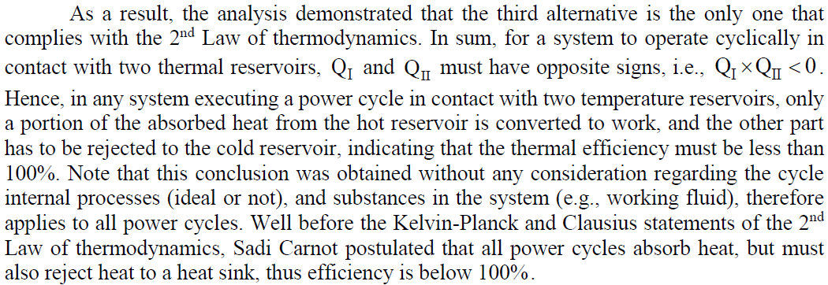

Slide 13
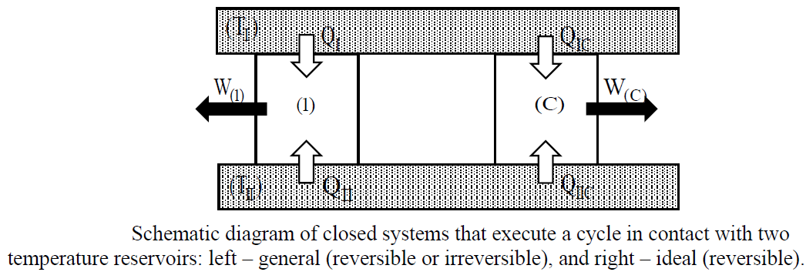
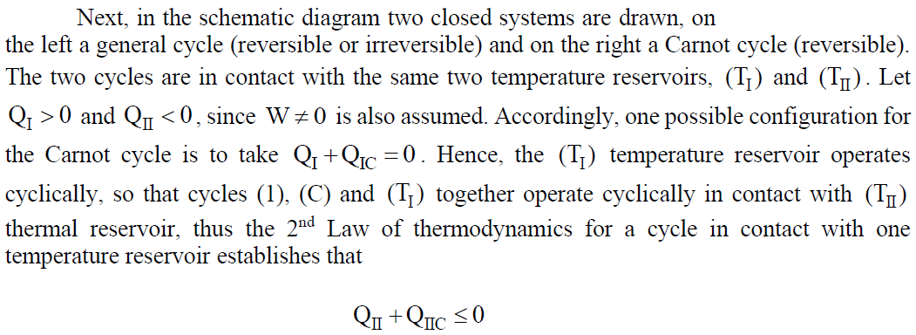

Slide 14
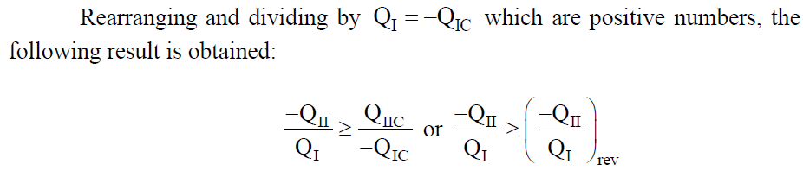
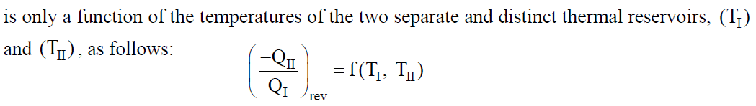
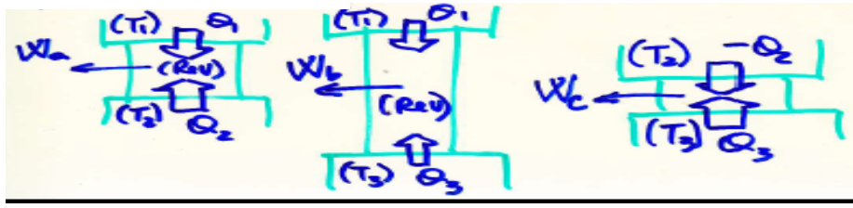
LIMITE INFERIOR REVERSÍVEL
(Rev)

Slide 15
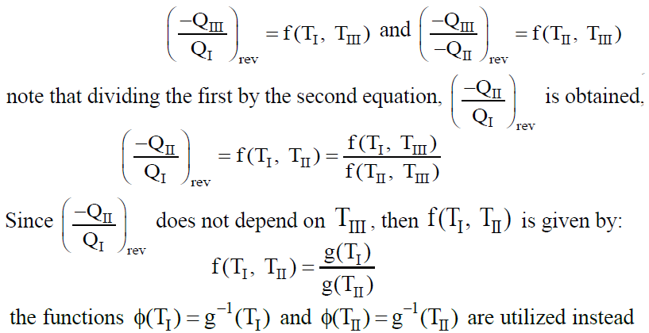
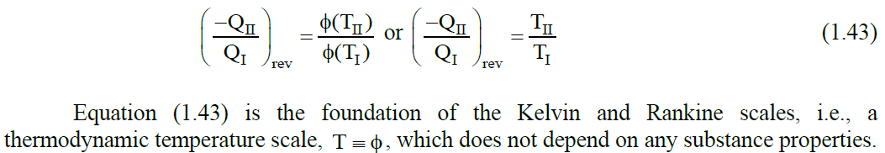

Slide 16
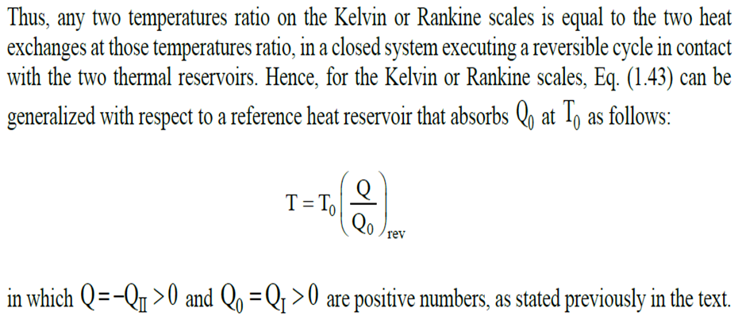
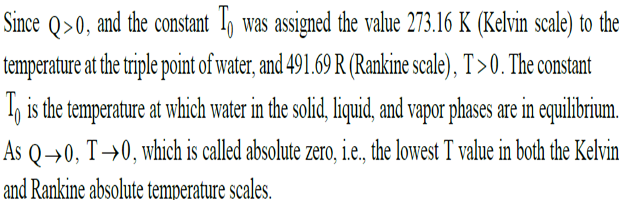

Slide 17









and
For a cycle in contact with one temperature reservoir:
For a cycle in contact with N temperature reservoirs:
For a reversible cycle:
Therefore, a “new” property named entropy was proposed
by Clausius:

Slide 18
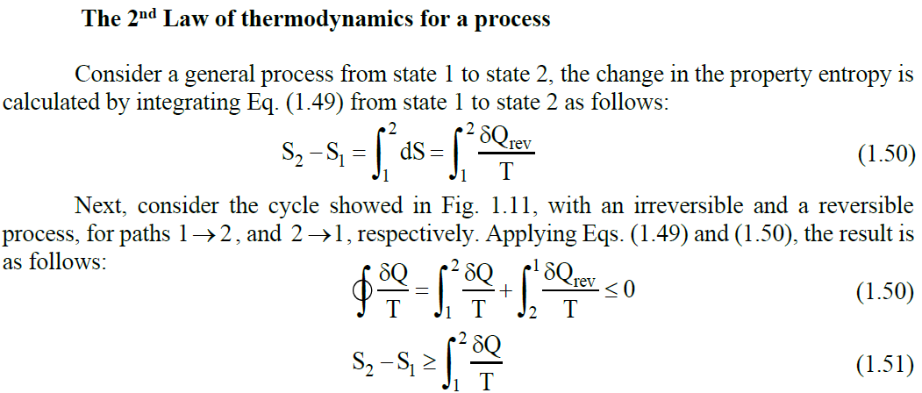
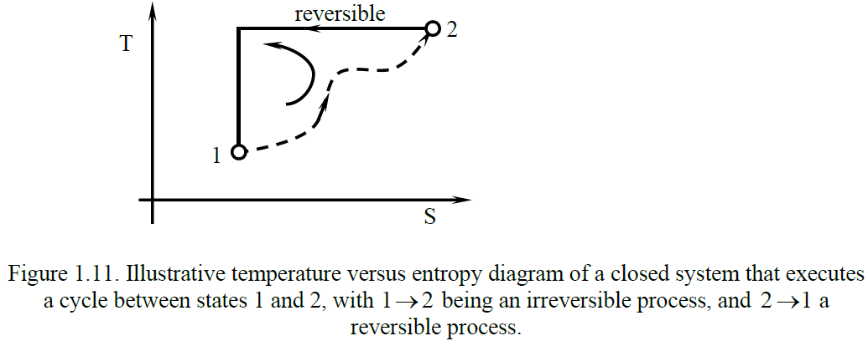

Slide 19
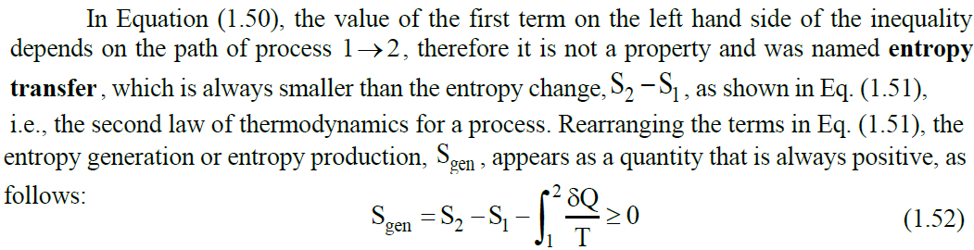
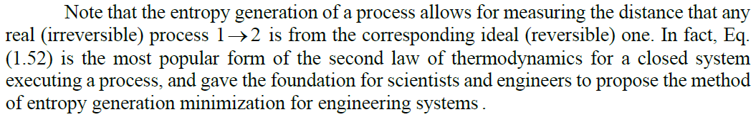

Slide 20
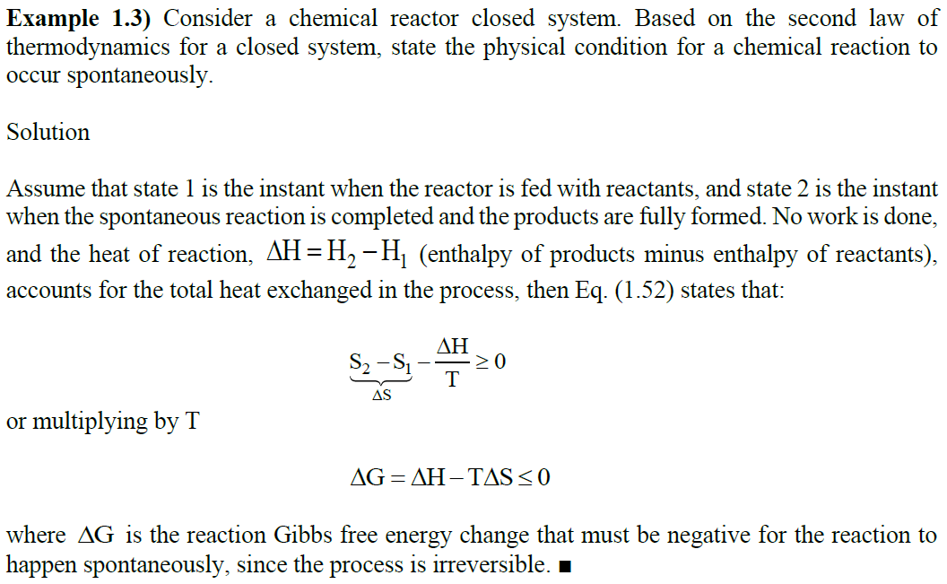

Slide 21
2ª Lei para sistemas abertos (Volume de controle)

Slide 22
2ª Lei para sistemas abertos (Volume de controle)
Chamando de a entropia gerada de

Slide 24
Termodinâmica do Não-equilíbrio
Ilya Prigogine
Nobel Prize for Chemistry (1977)
Sistema longe do equilíbrio
→ menor entropia → Estruturas dissipativas

Slide 25
Third law of thermodynamics
(Walther Hermann Nernst – Nobel de Química de 1920)
The entropy of a closed system at thermodynamic equilibrium approaches a constant value when its temperature approaches absolute zero. This constant value cannot depend on any other parameters characterizing the system, such as pressure or applied magnetic field. At absolute zero (zero kelvins) the system must be in a state with the minimum possible energy.
Entropy is related to the number of accessible microstates, and there is typically one unique state (called the ground state) with minimum energy. In such a case, the entropy at absolute zero will be exactly zero.

Slide 26
Constructal theory
Evolution Theory – originally conceived for biological organisms (Darwin, C., The origin of species, 1859)
Constructal Law – unifies all systems design (Bejan, 1996) “For a flow system to persist in time (to survive) it must evolve in such a way that it provides easier and easier access to the currents that flow through it” → any system evolves (morphs) to minimize resistances to the flows required for its existence…
Traditional thermodynamic design: assumed components geometry (or configuration) → optimization
Constructal design: physical laws-based generation of flow-system architecture → components free to morph
New: focus on the principle and method of generating geometry (shape, structure, configuration)

