Slide 1







ENERGY
SUSTAINABILITY
RESEARCH & DEVELOPMENT CENTER
A volume element model (VEM) for energy systems engineering
J. V. C. Vargas, PhD
DILAY, E. ; Vargas, J. V. C. ; SOUZA, J. A. ; ORDONEZ, J. C. ; YANG, S. ; MARIANO, A. B. . A volume element model (VEM) for energy systems engineering. International Journal of Energy Research (Print), v. 39, p. 46-74, 2015.

Slide 2
TOPICS
INTRODUCTION
CHALLENGE AND OBJECTIVE
THE VOLUME ELEMENT MODEL
NOTIONAL ALL ELECTRIC SHIP
MICROALGAE DERIVED HYDROGEN
CONSTRUCTAL PEMFC DESIGN
CONCLUSIONS

Slide 3
1. INTRODUCTION
Systems engineering (SE) – development of complex artificial systems
Ex: ships, airplanes, oil refinery, power plants, bioenergy-mechanical systems
Multidisciplinarity → Simulation
Computers’ finite processing capacity → Model complexity – critical decision in SE
How several sets of operating and design parameters affect system performance? Optimization maybe impossible if too much computational time
Simulation takes 1 day to complete – 10 parameters with 5 values → 267 years for only 1%
Same case – If simulation takes a second → 1 day to complete

Slide 4
1. INTRODUCTION

Slide 5
2. CHALLENGE AND OBJECTIVE
Modeling techniques mature, precise, and robust for components → local level
Global level in SE → complexity → not as advanced
Modeling, simulation, and optimization in SE → still challenges to overcome
OBJECTIVE:
Propose method for compact mathematical modeling for dynamic simulations in SE → early stage design, optimization, and potential use in controls

Slide 6
3. THE VOLUME ELEMENT MODEL

Slide 7
3. THE VOLUME ELEMENT MODEL
local method → derivatives depend only on variable neighborhood (e.g., FD, FE, FV, VEM)
global methods → derivatives depend on variable behavior everywhere (nonzero functions – entire domain) – spectral methods
Governing equations → conservation of mass, energy, and species applied to each volume element

Slide 8
3. THE VOLUME ELEMENT MODEL
Discretization: cell-centered finite volumes - solid, fluid, or both as subsystems
Mathematical model: velocity field is imposed
Numerical solution

Slide 9
3. THE VOLUME ELEMENT MODEL
Conservation of mass:
Conservation of energy:

Slide 10
THE VOLUME ELEMENT TYPES

Slide 11
MIXTURE ELEMENT IN VEM
Treat VE contents – homogeneous mixture uniform average properties or
Treat VE contents – group of distinct entities → subsystem for each
APPLICATIONS

Slide 12
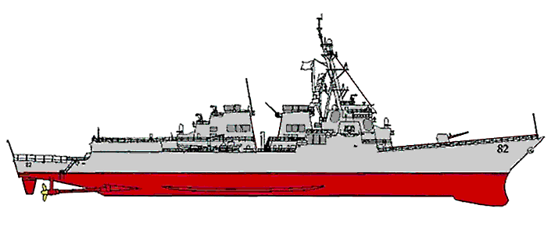
4. NOTIONAL ALL ELECTRIC SHIP (ESRDC)
Typical Cooling
Sub-systems:
Aux Seawater
Main Seawater
Chilled Water
Demin Water
Ethylene Glycol
HVAC
Direct Air
Firemain
Ultimate heat sink is either air (atmosphere) or ocean; open-loop systems are sea water and air.
Closed-loop systems transport heat from the generation point to the ultimate heat sinks.

Slide 14
vemESRDC

Slide 15
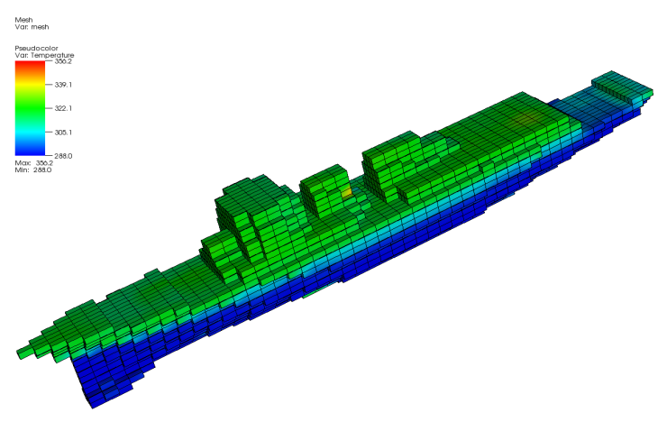
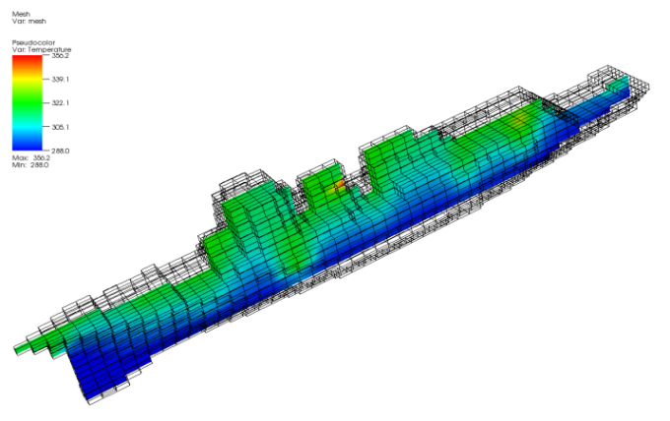

Slide 16
a) STBD M DCS zone 2 (left) and in radar zone 5 (right), b) on-board motor drive zone 3 (left) and on-board motor zone 3 (right) – effect of total equipment power variation (50%, 100%, 50% and 150%)

Slide 17
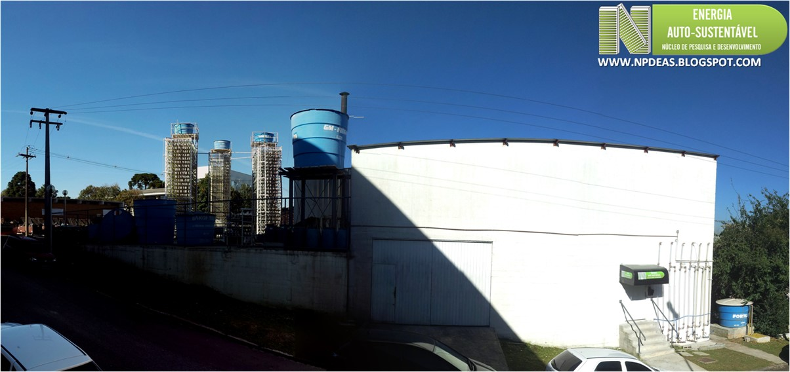
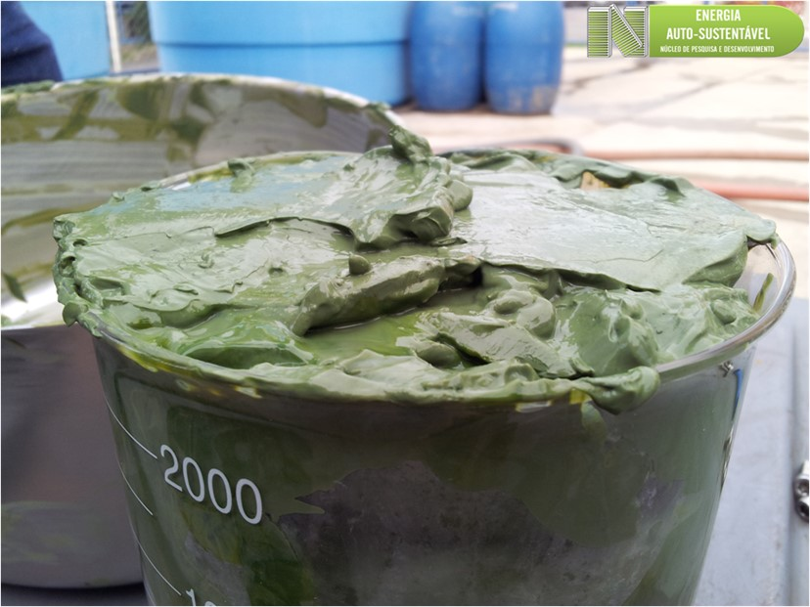
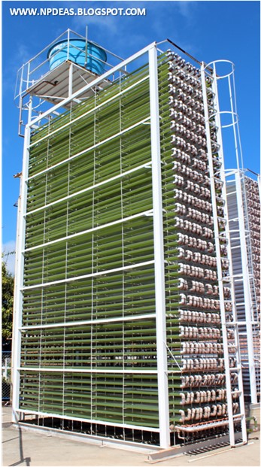
5. MICROALGAE DERIVED HYDROGEN

Slide 18

BIBLIOGRAPHIC REVIEW
Indirect Biophotolysis

Slide 19
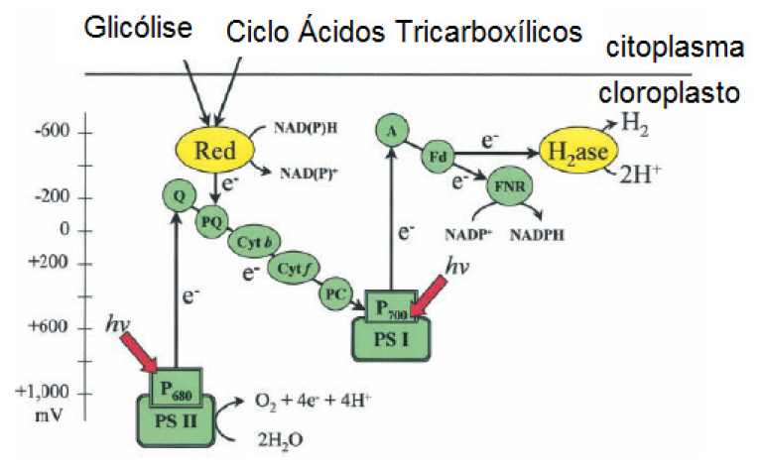
BIBLIOGRAPHIC REVIEW
Glycolysis
Tricarboxylic acid cycle
Cytoplasm
Chloroplast
First to report Hydrogen in green algae:
Graffon (1939) - Nature
Electron transport pathways related to hydrogenase in green algae.
The electrons could originate in the water photolysis or in the plastoquinone through cellular substrates oxidation via glycolysis or in the Krebs cycle. (MELIS and HAPPE, 2001).

Slide 20
BIBLIOGRAPHIC REVIEW
Challenges:
Low hydrogen generation rate
High cost
GMO
Engineering – PBR; contamination; purification, separation
Sensitivity to oxygen
Co-products (e.g., biodiesel)
Mathematical modeling

Slide 21
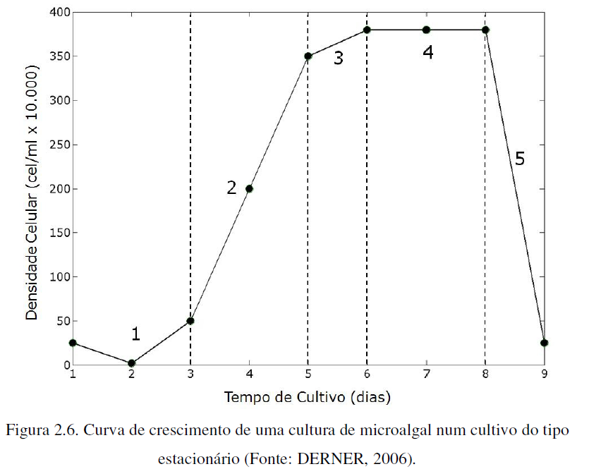
MATERIALS AND METHODS
Mathematical modeling
Stationary phase
Growth Reduction
Log phase
Death (nutrients/self-shading)
Cell density
Lag phase
Cultivation time (days)

Slide 22


MATERIALS AND METHODS

Slide 23

MATERIALS AND METHODS

Slide 24


MATERIALS AND METHODS
Loss to gaseous phase

Slide 25



MATERIALS AND METHODS

Slide 26
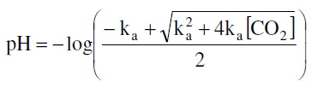

MATERIALS AND METHODS

Slide 27
RESULTS AND DISCUSSION
Total average sun irradiation: I_{sun,tot} = 500 W m⁻² (day) and 0 W m⁻² (night);
PBR temperature regime: between T_{min} = 283 and T_{max} = 303 K, and
Two simulation periods: 15 and 17 days, beginning at 5 AM.

Slide 28
.
Temperature distribution in the PBR at

Slide 29
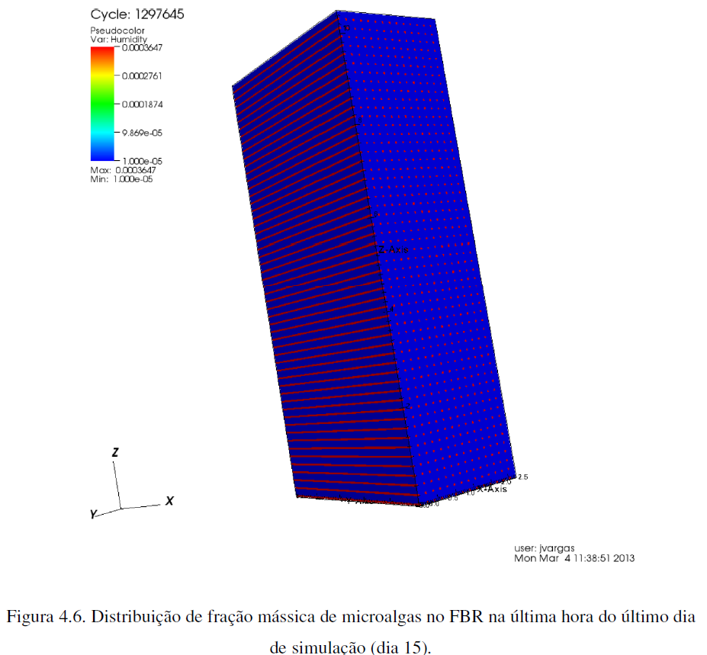

Slide 30
RESULTS AND DISCUSSION
Correlation between algae dry biomass and cell number

Slide 36
6. CONSTRUCTAL PEMFC DESIGN
Animate and inanimate systems design. Is it appropriate to separate them?
Made from the same chemical elements
Matter <-> Energy
Animate -> inanimate
Inanimate -> animate
Evolution Theory – originally conceived for biological organisms
Constructal Law – unifies all systems design

Slide 37
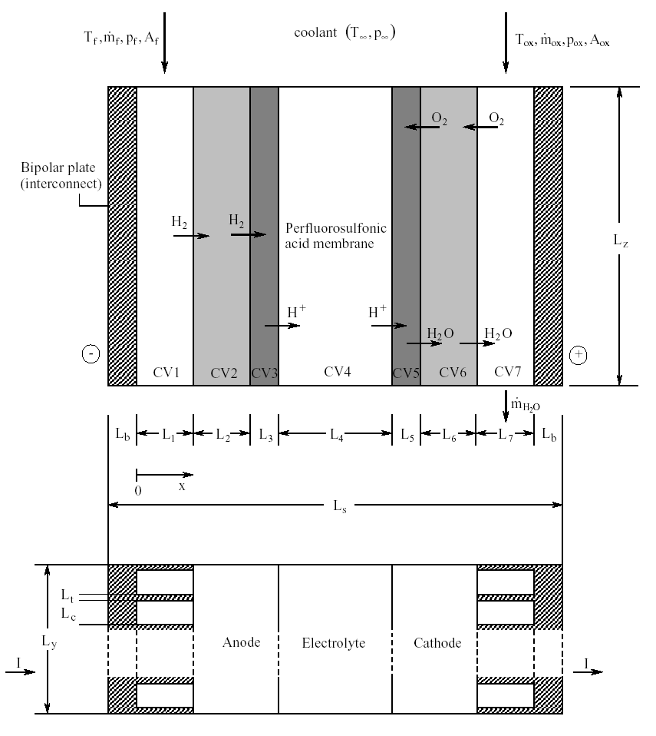
International Journal of Heat and Mass Transfer 48 (2005) 4410–4427
Constructal PEM fuel cell stack design
J.V.C. Vargas, J.C. Ordonez, A. Bejan

Slide 38
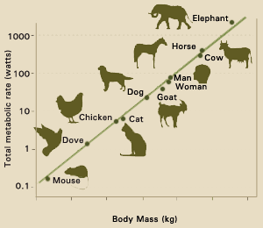
What have we learnt?
Slope ~ ¾
Fuel cell design
animal design
Metabolic rate
Animal size

Slide 39
7. CONCLUSIONS
Less than 10 minutes – steady-state AES – less than 50 minutes AES dynamic response
Indirect photolysis mathematical model for large PBR
Experimental validation for microalgae growth
Main innovation (VEM) – solid and fluid components coexist in VE in different phases
Low computational time and accuracy → design, simulation, control, and optimization in energy systems engineering

Slide 40
THANK YOU !

