Slide 1



Lecture Slides
Chapter 8
Screws, Fasteners,
and the Design of
Nonpermanent Joints
© 2015 by McGraw-Hill Education. This is proprietary material solely for authorized instructor use. Not authorized for sale or distribution in any manner. This document may not be copied, scanned, duplicated, forwarded, distributed, or posted on a website, in whole or part.

Slide 2
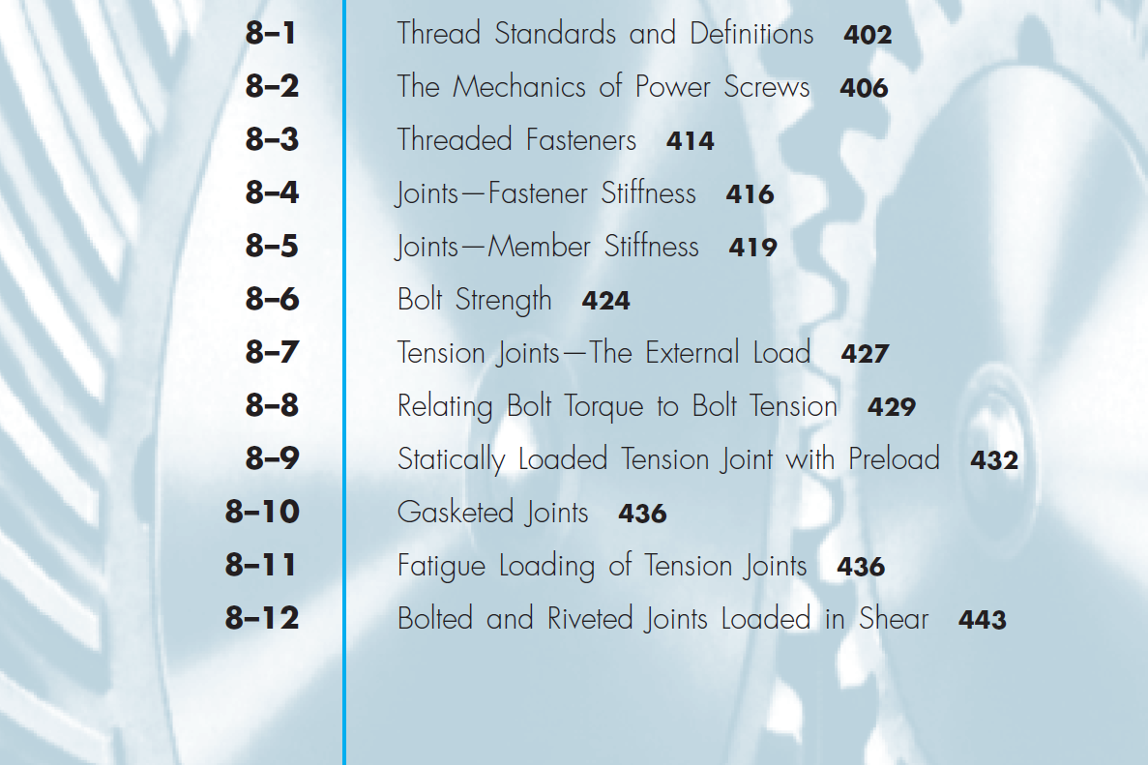
Chapter Outline

Slide 3
Reasons for Non-permanent Fasteners
Field assembly
Disassembly
Maintenance
Adjustment

Slide 4
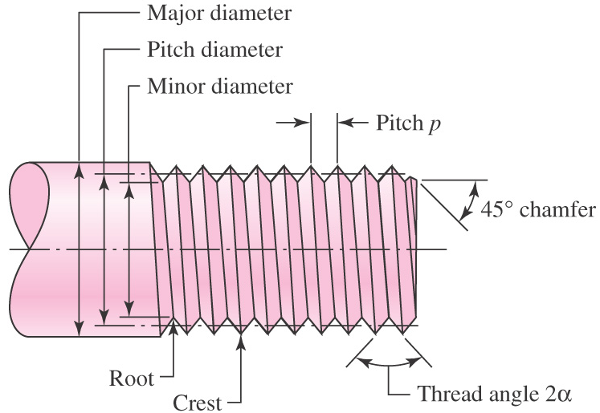
Thread Standards and Definitions
Pitch – distance between adjacent threads. Reciprocal of threads per inch
Major diameter – largest diameter of thread
Minor diameter – smallest diameter of thread
Pitch diameter – theoretical diameter between major and minor diameters, where tooth and gap are same width
Fig. 8–1

Slide 5
Standardization
  The American National (Unified) thread standard defines basic thread geometry for uniformity and interchangeability
  American National (Unified) thread
    UN normal thread
    UNR greater root radius for fatigue applications
  Metric thread
    M series (normal thread)
    MJ series (greater root radius)

Slide 6
Standardization
  Coarse series UNC
    General assembly
    Frequent disassembly
    Not good for vibrations
    The “normal” thread to specify
  Fine series UNF
    Good for vibrations
    Good for adjustments
    Automotive and aircraft
  Extra Fine series UNEF
    Good for shock and large vibrations
    High grade alloy
    Instrumentation
    Aircraft

Slide 7
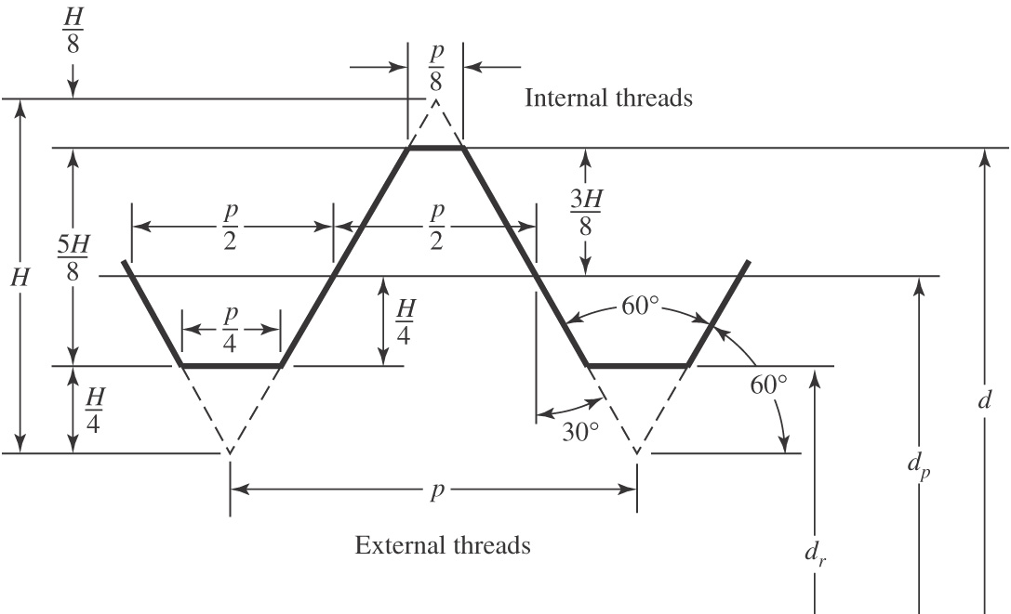
Standardization
Basic profile for metric M and MJ threads shown in Fig. 8–2
Tables 8–1 and 8–2 define basic dimensions for standard threads
Fig. 8–2

Slide 8
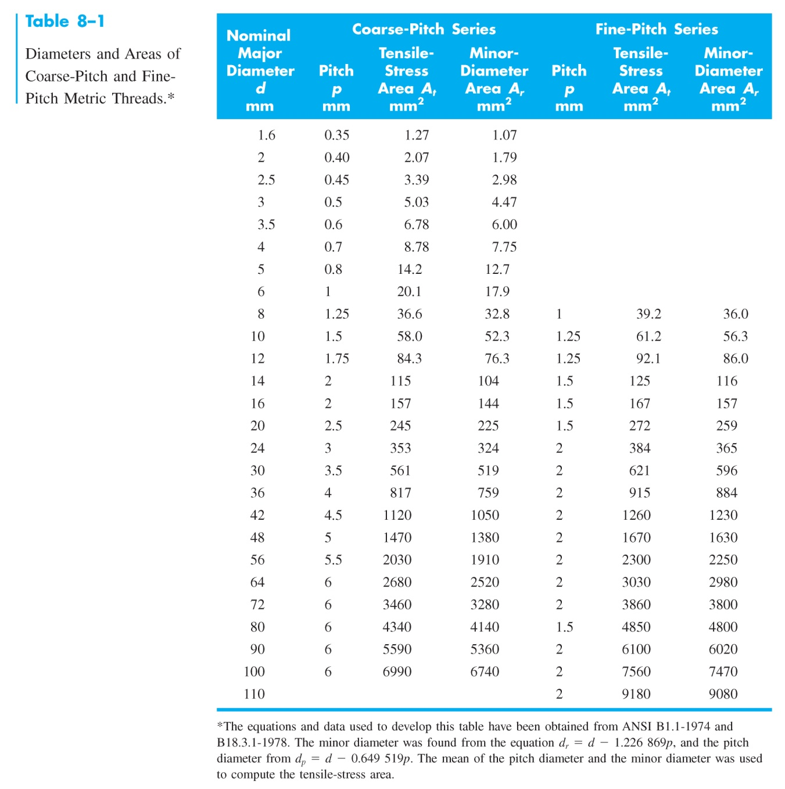
Diameters and Areas for Metric Threads

Slide 9
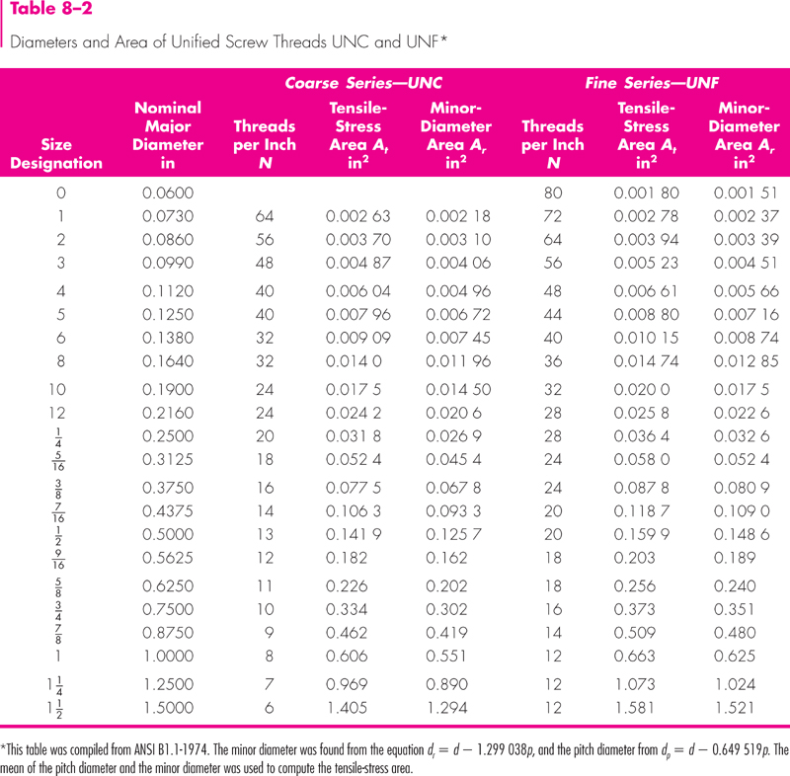
Diameters and Areas for Unified Screw Threads
Table 8–2

Slide 10
Tensile Stress Area
  The tensile stress area, A_{t} , is the area of an unthreaded rod with the same tensile strength as a threaded rod.
  It is the effective area of a threaded rod to be used for stress calculations.
  The diameter of this unthreaded rod is the average of the pitch diameter and the minor diameter of the threaded rod.

Slide 11
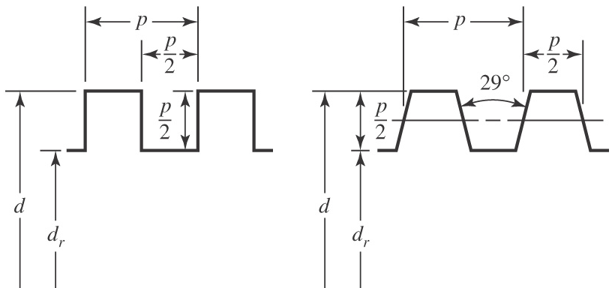
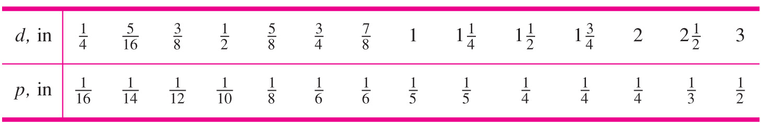
Square and Acme Threads
Square and Acme threads are used when the threads are intended to transmit power
Fig. 8–3
Table 8–3 Preferred Pitches for Acme Threads

Slide 12
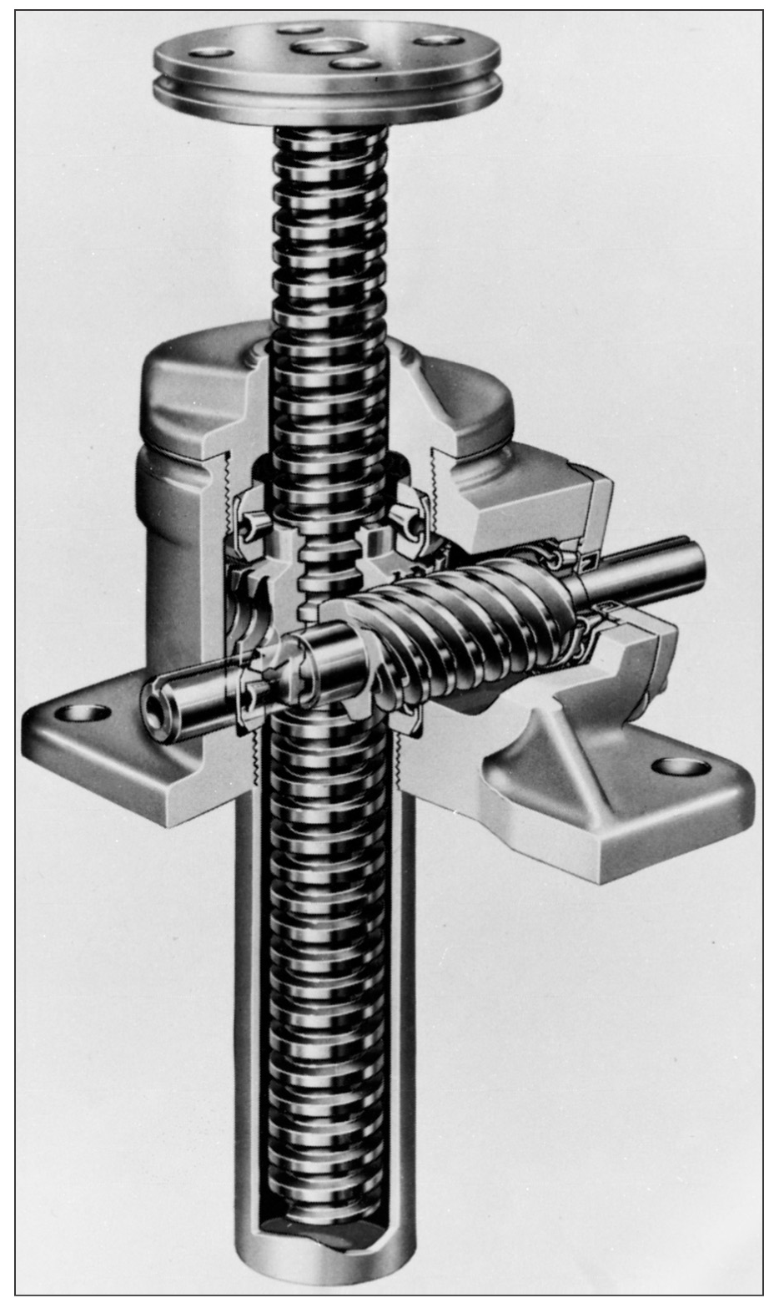
Mechanics of Power Screws
Power screw
  Used to change angular motion into linear motion
  Usually transmits power
  Examples include vises, presses, jacks, lead screw on lathe
Fig. 8–4

Slide 13
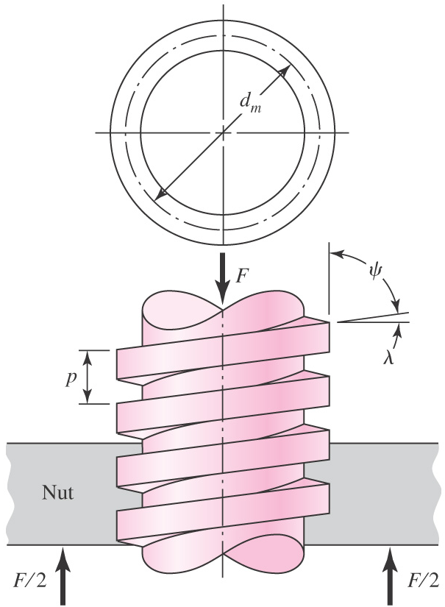
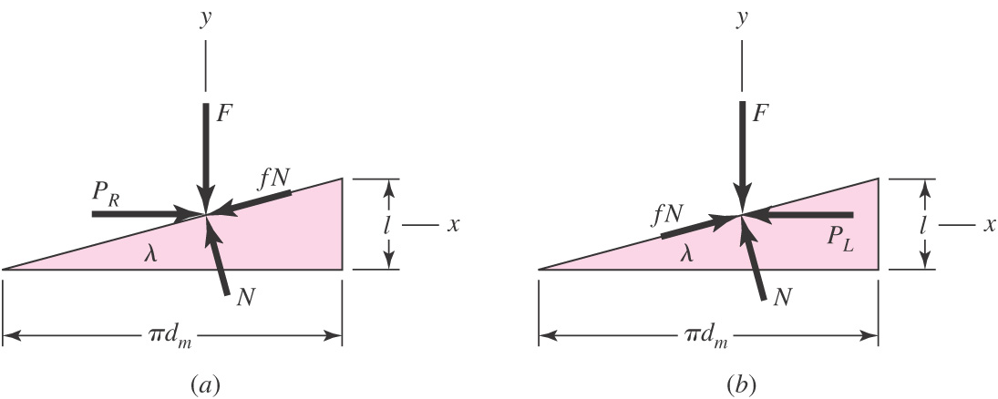
Mechanics of Power Screws
Find expression for torque required to raise or lower a load
Unroll one turn of a thread
Treat thread as inclined plane
Do force analysis
Fig. 8–5
Fig. 8–6

Slide 14
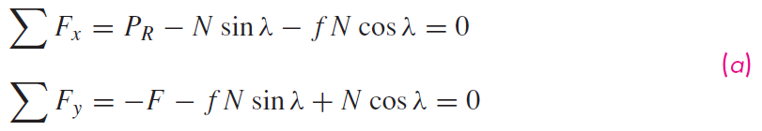
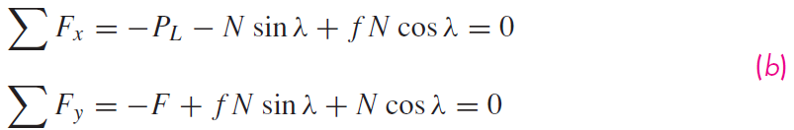
Mechanics of Power Screws
For raising the load
For lowering the load
Fig. 8–6

Slide 15


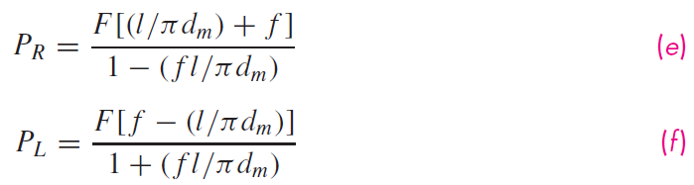
Mechanics of Power Screws
Eliminate N and solve for P to raise and lower the load
Divide numerator and denominator by cosλ and use relation
tanλ = l /π d_{m}

Slide 16


Raising and Lowering Torque
Noting that the torque is the product of the force and the mean radius,

Slide 17
Self-locking Condition
If the lowering torque is negative, the load will lower itself by causing the screw to spin without any external effort.
If the lowering torque is positive, the screw is self-locking.
Self-locking condition is π f d_{m} > l
Noting that l / π d_{m} = tan λ, the self-locking condition can be seen to only involve the coefficient of friction and the lead angle.

Slide 18


Power Screw Efficiency
The torque needed to raise the load with no friction losses can be found from Eq. (8–1) with f = 0.
The efficiency of the power screw is therefore

Slide 19
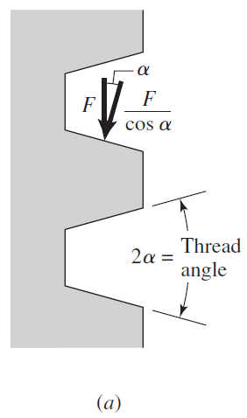

Power Screws with Acme Threads
If Acme threads are used instead of square threads, the thread angle creates a wedging action.
The friction components are increased.
The torque necessary to raise a load (or tighten a screw) is found by dividing the friction terms in Eq. (8–1) by cosα.
Fig. 8–7

Slide 20
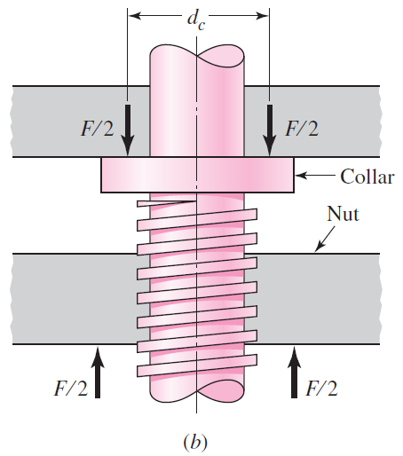


Collar Friction
An additional component of torque is often needed to account for the friction between a collar and the load.
Assuming the load is concentrated at the mean collar diameter d_{c}
Fig. 8–7

Slide 21


Stresses in Body of Power Screws
Maximum nominal shear stress in torsion of the screw body
Axial stress in screw body

Slide 22

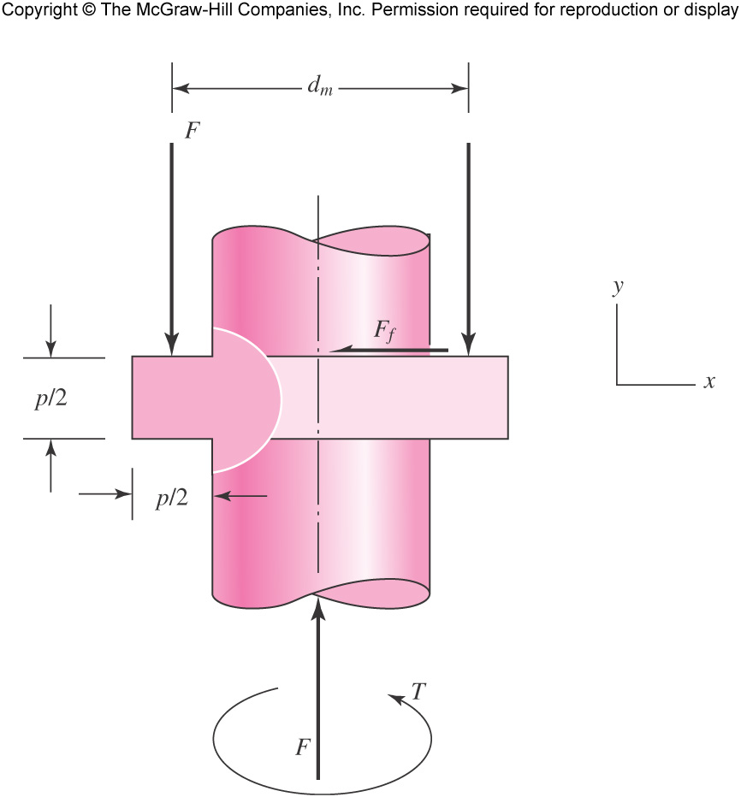
Stresses in Threads of Power Screws
Bearing stress in threads,
where n_{t} is number of
engaged threads
Fig. 8–8

Slide 23




Stresses in Threads of Power Screws
Bending stress at root of thread,
Fig. 8–8

Slide 24

Stresses in Threads of Power Screws
Transverse shear stress at center of root
of thread,
Fig. 8–8

Slide 25
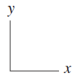
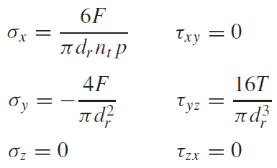
Stresses in Threads of Power Screws
Consider stress element at the top of the root “plane”
Obtain von Mises stress from Eq. (5–14),

Slide 26
Thread Deformation in Screw-Nut Combination
Power screw thread is in compression, causing elastic shortening of screw thread pitch.
Engaging nut is in tension, causing elastic lengthening of the nut thread pitch.
Consequently, the engaged threads cannot share the load equally.
Experiments indicate the first thread carries 38% of the load, the second thread 25%, and the third thread 18%. The seventh thread is free of load.
To find the largest stress in the first thread of a screw-nut combination, use 0.38F in place of F, and set n_{t} = 1.

