Slide 1
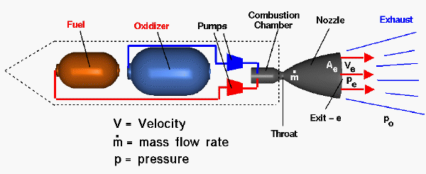
Rocket Physics Production of Thrust
LabRat Scientific
© 2018

Slide 2
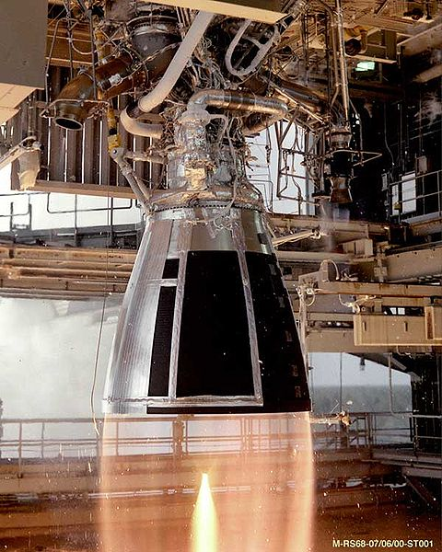
A rocket motor is a device that generates pressure in order to accelerate a gas so a forward force can be generated…

Slide 3
Relevant Concepts
Combustion
A chemical reaction which involves matter changing from one state to another (i.e. solid gas)
Heat and light are generated during the combustion process
Gas Dynamics
Gas will move from an area of high pressure to an area of low pressure
As the velocity of a gas increases, its pressure will decrease
Gas molecules must follow Newton’s Laws of Motion
Subsonic and Supersonic gas flows behave differently

Slide 4
Combustion
There are three things are needed for combustion to occur:
8
O
15.9994
Oxygen
Fuel
Oxygen
Heat
If any one of these is absent, the combustion process will cease…

Slide 5
Combustion
A rocket motor contains its own fuel and oxygen.
All that is needed is a bunch of heat to get a self sustaining chemical reaction (combustion) to occur. A heat producing igniter of some sort is usually needed to get the reaction going.
If a rocket motor has its own oxygen, then it should be able to burn in the vacuum of space, or even under water…
Watch the LabRat companion video for proof…

Slide 6
Combustion
The combustion process converts a solid (or liquid) into a gas (this is known as a “change in state”)…
A gas takes up more space than a solid (or liquid), so if the volume of the container (combustion chamber) is constrained, then the pressure inside the container will go up as the solid is converted into a gas…
If a hole at one end of the container is provided, the high pressure gas will move through that hole to get to the lower pressure outside the container.
This change in state and associated gas dynamics are what makes a rocket motor work…

Slide 7
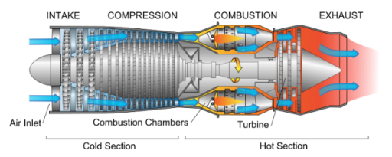
Rocket Motor vs. Jet Engine
A rocket motor carries its own oxidizer (oxygen)
A jet engine has to take in air (which contains about 30% oxygen) in order for combustion to occur
A solid propellant rocket motor has no moving parts
In general, a rocket motor contains more energy per pound
Fuel and Oxidizer

Slide 8
Primary Rocket Motor Types
Fuel and Oxidizer
Oxidizer
(liquid)
Solid
Fuel
(liquid)
Fuel (solid)
Oxidizer (liquid)
Hybrid
Liquid

Slide 9
Solid Propellant Rocket Motors
Propellant is in solid form
Propellant includes fuel, oxidizer, and a binder
Simple solid motors have no moving parts
Liquid Fuel Rocket Motors
Liquid Oxidizer (typically liquid oxygen)
Liquid Fuel (gasoline, liquid hydrogen)
Fuel is fed into the combustion changer via high pressure pumps of by using pressurized gas such as helium
Hybrid Rocket Motors
Solid fuel (various plastics and rubber, asphalt, almost any carbon material)
Liquid oxidizer (liquid oxygen, nitrous oxide)
Fuel is contained in the combustions chamber like a solid motor, but oxidizer is fed via pumps or pressure.

Slide 10
Solid Propellant Rocket Motors
Tend to be very robust (military uses then extensively)
Generally no moving parts (though guided versions using gimballed nozzles are used)
Can be loaded and launched quickly
Liquid Fuel Rocket Motors
Generally more energetic (have a higher Specific Impulse)
Can be throttled and stopped/started to better control flight trajectories
Are more complex due to plumbing and pumps
Hybrid Rocket Motors
Complexity is generally between that of the liquid and solid
Can be throttled and stopped/started to better control flight trajectories
Some say hybrids combine the best of both types of motors – while other say they combine the worst of both types of motors

Slide 11
Let’s get down to the Physics…
Let’s start off by looking at a balloon model that represents the pressure situation in a rocket motor.

Slide 12
Rocket Thrust
High Pressure = Lots of molecules bouncing around.
Prior to ignition, the molecules inside the combustion chamber are at rest.

Slide 13
Rocket Thrust
Atmospheric Pressure – generally a lot lower than the pressure inside the rocket motor.
High Pressure = Lots of molecules bouncing around.
Once the propellant is ignited, the solid fuel is converted to a high pressure gas. The molecules will move from the area of high pressure inside the motor towards the low pressure outside the rocket motor.
It is this internal pressure that creates the thrusting force…

Slide 14
The Balloon Model
If the balloon is inflated and the inflation tube is tied closed, the internal pressure of the gas inside is equal in all directions.
P_{a} is the external Atmospheric Pressure
P_{a}
P_{c}
P_{c} is the internal “Chamber” Pressure
If the pressure forces are balanced, then there will be no change in motion.

Slide 15
Now, let’s open the inflation tube and let the internal air to start rushing out…
With the inflation tube open, there is no surface for the internal pressure to push against. This results in a pressure imbalance inside the balloon.
P_{a}
P_{c}

Slide 16
First, let’s examine what is happening on the front (left-hand end) of the balloon.
P_{a}
P_{c}
F_{Front} = (P_{c} - P_{a}) * A
The internal pressure ( P_{c} ) is acting towards the left and the atmospheric pressure (P_{a} ) is acting towards the right. The resultant pressure is the difference between the two. The actual force acting on the front of the balloon is the pressure differential multiplied by the area over which the pressure is acting.

Slide 17
P_{a}
P_{c}
F_{Front} = (P_{c} - P_{a}) * A
The Area (A) is the cross-sectional area of the inflation tube located at the back of the balloon (as stated earlier, when the tube is open there is no balloon surface for the internal pressure to push against).

Slide 18
For this simplified balloon model, this is the only force pushing the balloon forward.
P_{a}
P_{c}
F_{Front} = (P_{c} - P_{a}) * A
Now, Newton says “for every action there is an equal and opposite reaction”. For this analysis we define this force on the front of the balloon as the “reaction”. That said, there needs to be some “action”. To identify that “action” we need to examine what is happening at the back of the balloon.

Slide 19
Here we are examining the back (right-hand side) of the balloon. The air is escaping out the back of the balloon through the inflation tube.
P_{c}
Air rushing out of the balloon
We can neglect all the internal pressure forces for the time being.

Slide 20
With the inflation tube at the back of the balloon open, the high pressure air starts to move towards the lower pressure region outside the balloon. This moving air has mass and thus also has momentum.
P_{c}
Air rushing out of the balloon
By definition, Momentum = Mass * Velocity. Also by definition, the time varying change in the momentum is a force. This force acts in the direction of the airflow (to the right). In this example, this force is known as the “action” force, and it is opposite the “reaction” force previously discussed.

Slide 21
Force_{Momentum} = (Mass * Velocity) / Time
P_{c}
Air rushing out of the balloon
We are looking at the momentum of the air as it passes the exit plane of the inflation tube. There is something else going on at this location – the moving air still has some pressure and it is interacting with the atmospheric pressure right at the opening.

Slide 22
P_{e} is low due to the velocity of the escaping air, and this pressure is generally going to be less than the atmospheric pressure P_{a}.
P_{a}
P_{c}
P_{e}
Examining the magnitude of the arrow in the diagram, which depicts P_{a} being larger than P_{e} , we should realize that the resulting pressure imbalance is towards the left. This is opposite the momentum force.

Slide 23
As identified earlier, the resulting pressure force due P_{a} and P_{e} can be calulated.
P_{a}
P_{c}
P_{e}
F_{Pressure at rear} = (P_{a} - P_{e}) * A

Slide 24
So the “action” force is a combination of the two forces at the back of the balloon.
P_{c}
P_{e}
F_{Action} = F_{Momentum} - F_{Pressure at rear}
F_{Action} = (Mass * Velocity) / Time - (P_{a} - P_{e}) * A

Slide 25
F_{Action} = (Mass * Velocity) / Time - (P_{a} - P_{e}) * A
Now, Newton says that “for every action there is a equal and opposite reaction”. This means we can set the Action and Reaction force equation equal to one another.
Action = Reaction
(Mass * Velocity) / Time - (P_{a} - P_{e}) * A = (P_{c} - P_{a}) * A
If we perform some basic algebra on the pressure terms, we can come up with a more common expression of the equation…
(Mass * Velocity) / Time + (P_{e} - P_{a}) * A = (P_{c} - P_{a}) * A

Slide 26
(Mass * Velocity) / Time + (P_{e} - P_{a}) * A = (P_{c} - P_{a}) * A
a.k.a. Momentum Thrust
a.k.a. Pressure Thrust
Unfortunately a rocket motor is a little more complicated than the balloon example because a rocket motor has a nozzle…

Slide 27
Pressure Thrust in a Rocket Motor
P_{a}
P_{c}
Area = in²
The rocket motor without a nozzle looks very similar to the balloon model.

Slide 28
Pressure Thrust in a Rocket Motor with a Nozzle
P_{a}
P_{c}
P_{a}
P_{c}
P_{a}

Slide 29
Pressure Thrust in a Rocket Motor with a Nozzle
P_{a}
P_{c}
P_{c}
P_{a}
The RED pressure arrows depicted in the nozzle reflect the pressures shown graphically on the pressure plot (the pressure decreases as the gas moves through the exit cone).

Slide 30
P_{a}
P_{c}
We can calculate the axial and radial components if we know the pressure profile in the nozzle and the associated angles of the exit cone.

Slide 31
A_{t}
A_{e}
P_{a}
P_{c}
P_{a}
P_{t}
P_{e}
A_{t} = Throat Area
P_{t} = Throat Pressure
A_{e} = Exit Area
P_{e} = Exit Pressure
We can approximate the total pressure force using the following equation:
F_{pressure} = (P_{c} - P_{e}) * A_{t} - (P_{a} - P_{e}) * A_{e}

Slide 32
Generic Pressure and Velocity in a Solid Rocket Motor
Combustion Chamber
Nozzle
Gas Velocity
Notice that the pressure just past the throat is about 66% of the chamber pressure.
Gas Pressure

Slide 33
Is this Theory Valid?
We can apply this theory to a known rocket motor to see if the theoretical result is reasonable.
The spreadsheet on the next slide models a NASA Sounding Rocket Motor. The Chamber Pressure, Nozzle Geometry, and Average Thrust is known. The subject motor produces approximately 20,000 lbs of thrust. The theoretical approximation results in a thrust of 20,550 lbs.
The thrust values are nearly identical…

Slide 35
Thrust
The two equations that represent the Momentum Thrust and Pressure Thrust are as follows:
Pressure Thrust
Thrust_{Pressure} = (P_{e} - P_{a} ) x A_{e}
Momentum Thrust
Thrust_{Momentum} = Mass Flow Rate x Exhaust Velocity

Slide 36
Thrust
Engineers strive to optimize their designs, and a rocket motor is optimized when the gas leaving the nozzle is perfectly expanded – meaning that P_{e} = P_{a}. If this is the case, the velocity of the flow is maximized and the pressure thrust is zero… This being the case, we can just skip the pressure force.
Pressure Thrust
Thrust_{Pressure} = (P_{e} - P_{a} ) x A_{e}
Momentum Thrust
Thrust_{Momentum} = Mass Flow Rate x Exhaust Velocity

Slide 37
Momentum Thrust
Thrust_{Momentum} = Mass Flow Rate x Exhaust Velocity
Does this equation make sense? “Mass flow rate” and “velocity”? How does that give units for thrust?
We can perform a simple “unit analysis” to see what units result from the momentum thrust equation.

Slide 38
Lb
-------------
Ft
-----
Sec² Ft
Thrust = ----------------- x -------
Sec Sec
Mass Flow Rate
Mass
Mass Flow Rate is the amount of mass that flows out the nozzle every second…
Gas Velocity
Lb x Sec²
------------- Ft
Thrust = Ft x ------
---------------- Sec
Sec
Lb x Sec²
------------- Ft
Thrust = Ft x -------
---------------- Sec
Sec

Slide 39
Lb x Sec²
------------- Ft
Thrust = Ft
---------------- x ------
Sec Sec
Lb x Sec²
Thrust =
----------------
Sec²
So, the unit analysis of the momentum thrust equation results in the units of “Lbs”.
So, it does make sense…
Thrust = Lb

Slide 40
Momentum Thrust
Thrust_{Momentum} = Mass Flow Rate x Exhaust Velocity
To maximize thrust, we need to maximize the Mass Flow Rate and the Exhaust Velocity…
The Mass Flow Rate is how much stuff (mass) we pump out of the rocket motor every second…
A propellant that burns faster (higher burn rate) will dump its mass out in a shorter amount of time.
Thus, a faster burning propellant will have a higher mass flow rate…

Slide 41
Momentum Thrust
Thrust_{Momentum} = Mass Flow Rate x Exhaust Velocity
The Exhaust Velocity is how fast the stuff (mass) is moving once it leaves the rocket motor…
A nozzle is used to accelerate the gas flow and thus maximize the exhaust velocity.
See the LabRat lesson on rocket nozzles to get a better understanding of how a rocket nozzle works.

Slide 42
Oxidizer
(liquid)
Questions?
Fuel
(liquid)
Liquid

